Slide 1
Query processing for DDBMS

Slide 2
Overview over this video
We discuss some problems that comes up in DDBMS for query processing and an example of how to do better than the naïve approach in some cases

Slide 3
Query Processing in Distributed DBMS
B
Query
A
C
Try to answer query at site where query is raised
If not possible: request information from other sites
Slow → design database to reduce this as much as possible
Most expensive: joins

Slide 4
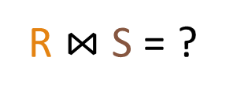
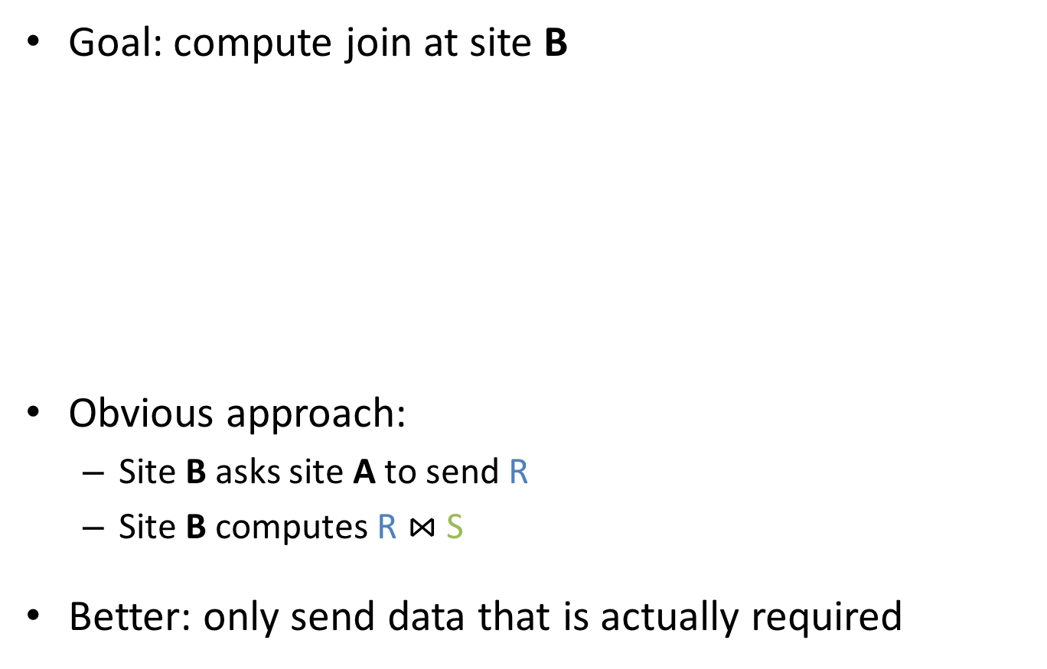
Joins
R $⋈$ S = ?
Goal: compute join at site B
Obvious approach:
Site B asks site A to send R
Site B computes R $⋈$ S
Better: only send data that is actually required
R
A
B
Might be slow
stores R
stores S
R might be very large – do we have to send all tuples?

Slide 5

Semijoins (⋉)
R ⋉ S := R $⋈$ $π$_{common attributes of R and S}(S)
Intuition: R ⋉ S = set of all tuples in R that NATURAL JOIN
at least one tuple in S
Modules
Lecturers
module | year
COMP105 | 1
COMP201 | 2
COMP207 | 2
name | module
J. Fearnley | COMP105
S. Coope | COMP201
module | year
COMP105 | 1
COMP201 | 2
Modules ⋉ Lecturers
=

Slide 6

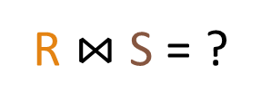
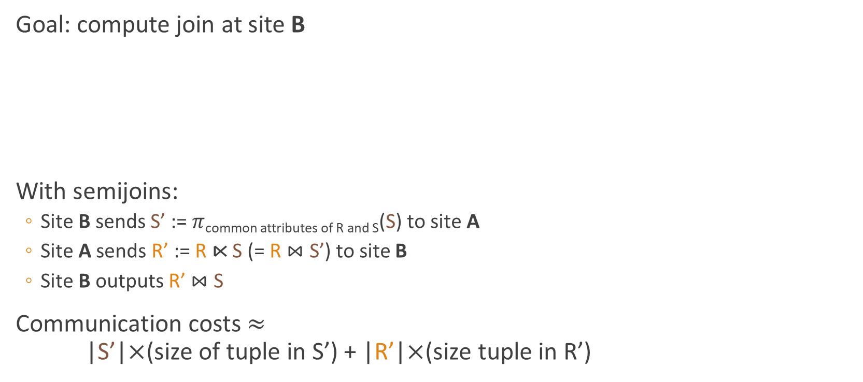
Semijoin Reduction
R $⋈$ S = ?
Goal: compute join at site B
With semijoins:
Site B sends S’ := $π$_{common attributes of R and S}(S) to site A
Site A sends R’ := R ⋉ S (= R $⋈$ S’) to site B
Site B outputs R’ $⋈$ S
Communication costs $≈$ |S’|$×$(size of tuple in S’) + |R’|$×$(size tuple in R’)
$π$…(S)
A
B
R ⋉ S
stores R
stores S

Slide 7
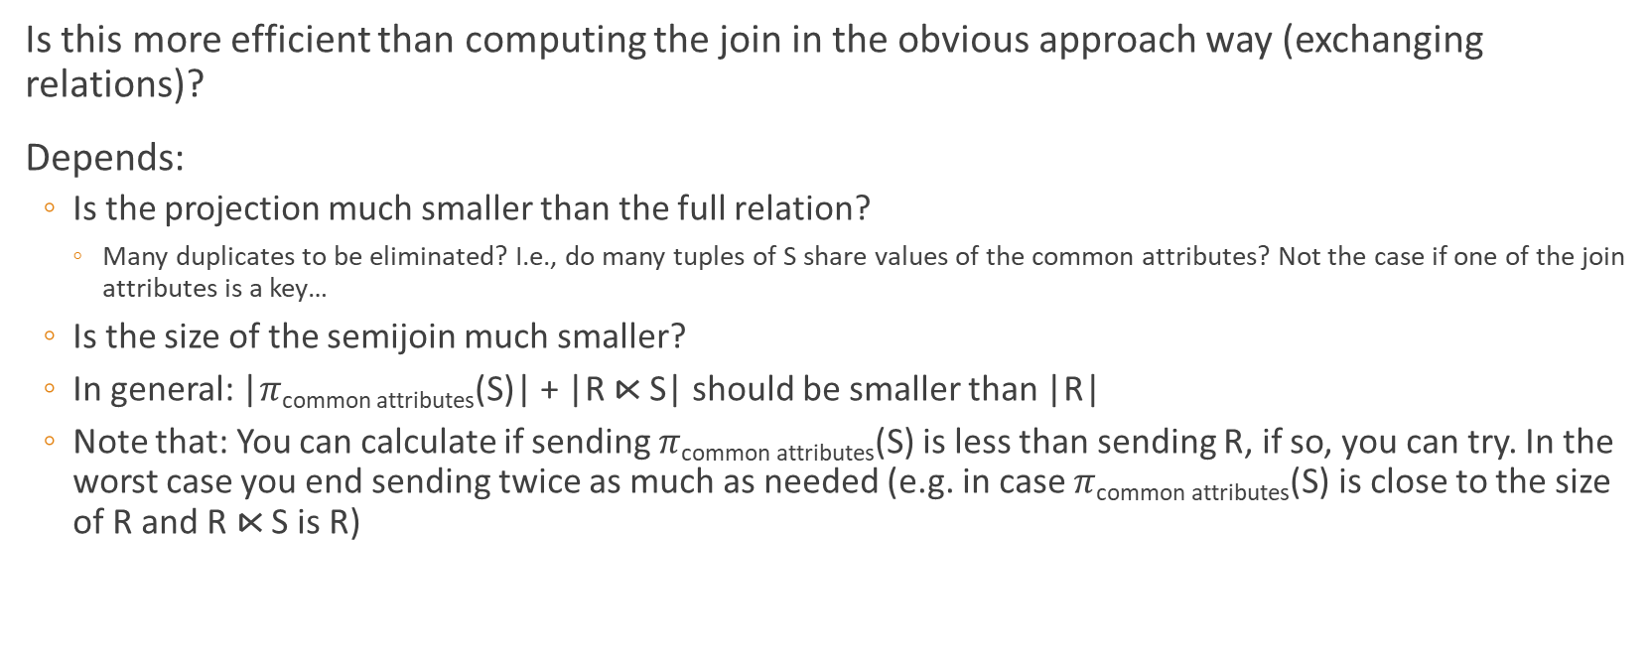
Efficiency
Is this more efficient than computing the join in the obvious approach way (exchanging relations)?
Depends:
Is the projection much smaller than the full relation?
Many duplicates to be eliminated? I.e., do many tuples of S share values of the common attributes? Not the case if one of the join attributes is a key…
Is the size of the semijoin much smaller?
In general: |$π$_{common attributes}(S)| + |R ⋉ S| should be smaller than |R|
Note that: You can calculate if sending $π$_{common attributes}(S) is less than sending R, if so, you can try. In the worst case you end sending twice as much as needed (e.g. in case $π$_{common attributes}(S) is close to the size of R and R ⋉ S is R)

Slide 8

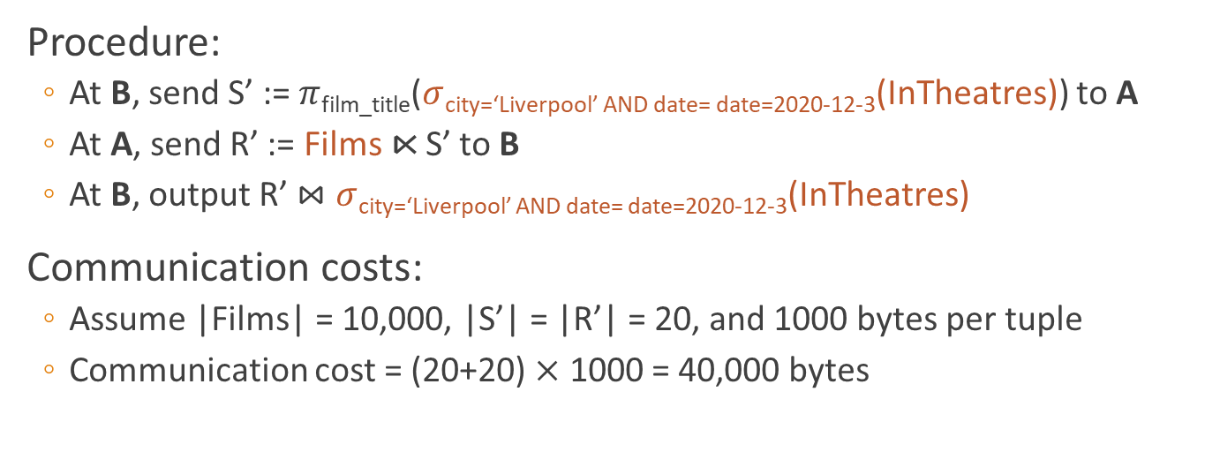
Example
Films $⋈$ $σ$city=‘Liverpool’ AND date=2020-12-3(InTheatres)
A
B
Films(film_title, genre, …)
InTheatres(film_title, theatre, city, date, …)
Procedure:
At B, send S’ := $π$_{film_title}($σ$city=‘Liverpool’ AND date= date=2020-12-3(InTheatres)) to A
At A, send R’ := Films ⋉ S’ to B
At B, output R’ $⋈$ $σ$city=‘Liverpool’ AND date= date=2020-12-3(InTheatres)
Communication costs:
Assume |Films| = 10,000, |S’| = |R’| = 20, and 1000 bytes per tuple
Communication cost = (20+20) $×$ 1000 = 40,000 bytes
10,000,000 bytes for obvious approach

Slide 9
Summary
Query processing have new challenges in DDBMS, because of the distributed nature of the database
We saw how to use Semijoins to in some cases speed up joins
Also, if you are watching these in order, this was it for the required part on distributed databases
There are some more videos on MapReduce – special programming framework that fits somewhere between distributed databases and the next topic of NoSQL databases (i.e. not only SQL databases)
Those are not required for the exam though

